Slide 1


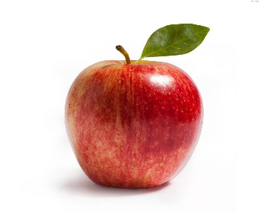


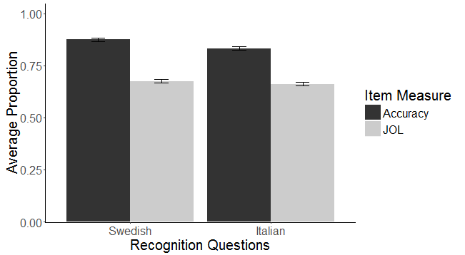
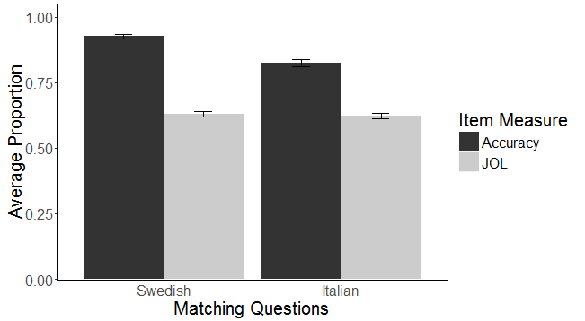
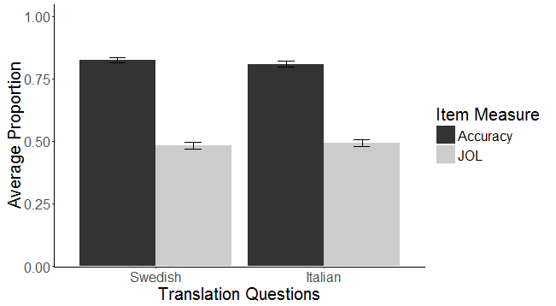
Linguistic Learning and Metacognition: Do We Learn Equally, and Do We Know it?
Rebecca E. Knoph, Bogdan Kostic, Erin M. Buchanan
Introduction
Based on the interference hypothesis (Whitley, 2002), we would expect that learning a language similar to our native language will be easier because of positive linguistic transfer.
This experiment examined how similar and dissimilar languages (as compared to English) were learned in a simple task to determine if learning was improved by positive transfer (a similar language; Swedish) or improved by lessened interference (a dissimilar language; Italian).
Additionally, we examined perceptions of learning these languages by asking participants to judge their learning (JOLs) during the task. Previous work on JOLs indicates that these judgments correlated with performance, albeit the slopes are fairly flat (Koriat & Bjork, 2005; Valentine & Buchanan, 2010). A review of the literature reveals that, while JOLs have been extensively studied, very little work has explored the relationship between JOLs and language learning.
Hypotheses
Hypothesis 1. Learning Swedish will be easier than learning Italian because participants can map similar features between English and Swedish due to their common linguistic background.
Hypothesis 2. JOLs will be positively correlated with performance, and these effects may be different across the two languages.
Participants
163 participants were recruited through introductory Psychology courses for course credit.
36% of the sample identified themselves as female; 63% as male.
Ages ranged from 18-50 years old (M = 19.47, SD = 2.21).
Procedure
All participants were directed to online survey software and were asked some brief demographic questions, such as expertise with the target languages and with Latin.
Participants then received a 20-minute lesson either on basic Swedish or basic Italian.
Although the language order was randomly assigned, the order of the questions remained constant and were matched for both languages.
Questions began as multiple choice for learning purposes, but increased in difficulty to include a block of multiple choice questions for testing purposes, a block of matching questions, and a block of sentence translation questions.
Participants also completed JOLs for each type of question at the beginning, middle, and end of each lesson.
Once participants concluded the lesson, they received the lesson for the second language, which was parallel to the first lesson.
Test Item Examples
Results
We used a multilevel model with a random intercept for participants as our analysis.
The dependent variable was question score.
The independent variables included main effects and the four-way interaction between type of question, target language, judgment of learning, and time spent taking both language tests.
Time spent taking the tests was a nonsignificant factor and was omitted from further analysis.
Hypothesis 1 was supported, as a main effect of language indicated that participants performed significantly better at Swedish than Italian.
Hypothesis 2 was supported, as JOL was a significant predictor of score on individual items (b = 0.06).
The three-way interaction was also significant. See the table below for the simple effects slopes.
For recognition and matching questions, a significant interaction between JOL and type appeared where Swedish slopes were lower than Italian slopes. However, this trend did not continue for translation questions where JOL did not interact with language.
Note: Significant p-values are indicated with an asterisk.
Discussion
Learning a language with similar features to our native language was easier as participants scored higher on Swedish items.
JOLs were significantly correlated with performance, where participants were able to somewhat adequately judge their skills during learning. These slopes were rather shallow, indicating replication from previous work on JOLs.
Interestingly, JOLs were better (i.e., closer to one) for Italian, potentially indicating that participants were aware of the possible negative transfer and adjusted their estimates.
These results increase our understanding of the cognitive and metacognitive processes that occur during second language learning.
Future research should demonstrate how languages are not equal in ease of learning, and how to take this into account in the educational field.
You can contact us at: Allinder115@live.missouristate.edu
Figure 1. Example item for screening multiple choice questions. Testing multiple choice questions appeared identical with the omission of pictures.
Figure 2. Example item for matching questions.
Drag the Italian word to the correct English word.
Which of these is “a boy”?
English Items
La donna La mela
Un ragazzo Una ragazza
Italian Items
donna
mela
una
un
Boy
ragazzo
Is
sono
I
io
Girl
ragazza
Figure 3. Example item for sentence translation questions.
Figure 4. Example item for judgment of learning questions.
Translate this sentence: Io sono un ragazzo.
You are now halfway through the Italian lesson. Please rate your confidence for answering the next set of questions correctly.
Translation: I am a boy.
Multiple Choice
Matching
Sentence Translation
0% 25% 50% 75% 100%
0% 25% 50% 75% 100%
Language
Type of Question |  | Swedish | Italian
 | Recognition | b = 0.04 (SE = 0.02) t(3180) = 1.53, p = 0.13 | b = 0.06 (SE = 0.03) t(3048) = 2.38, p = 0.02*
 | Matching | b = 0.03 (SE = 0.02) t(2467) = 1.24, p = 0.21 | b = 0.09 (SE = 0.04) t(2381) = 2.50, p = 0.01*
 | Translation | b = 0.04 (SE = 0.03) t(1774) = 1.77, p = 0.08 | b = 0.04 (SE = 0.03) t(1692) = 1.44, p = 0.15
0% 25% 50% 75% 100%

